Slide 1
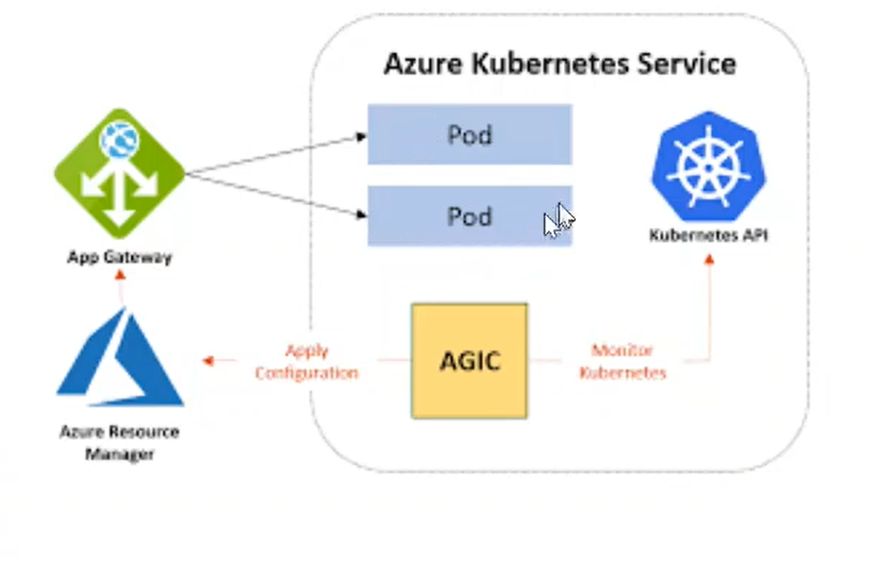
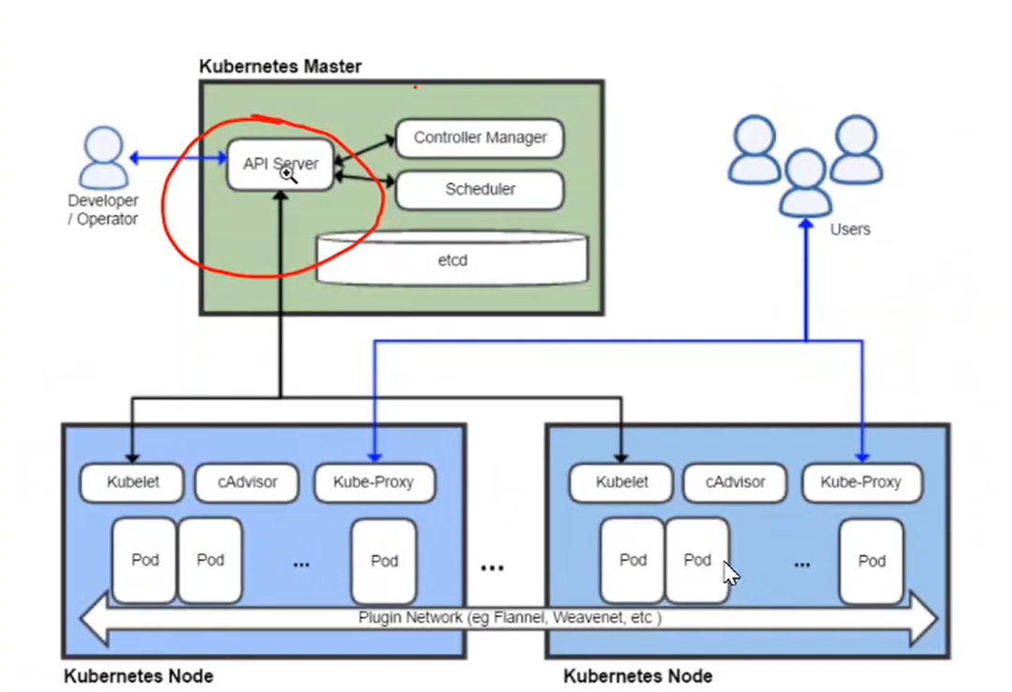
Azure Kubernetes service:
When we spin up the AKS cluster it provisions few things.
Aks cluster with help of nodes or VM scalesets.
Nodes something have pods. The pods are grouped under namespaces.
We can set up ingresses.
Each pod contains containers.
Ingress mapped to DNS. And DNS uses certs.
We can use app gateway to tag your particular IP’s.
Interacting to the AKS cluster we use something called API Server and traffic will comes to AKS cluster to pods based on service we kept at front line.

Slide 2
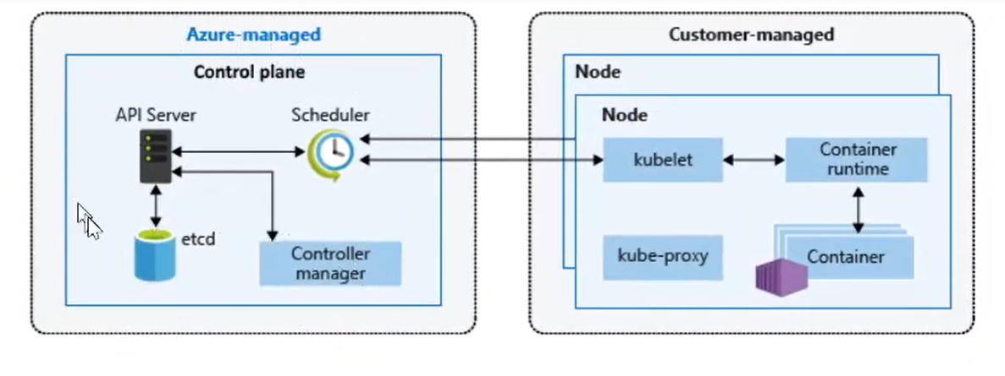
Kubernates:
It is cluster, which will have both nodes (workers) and masters.
Api Server: It acts as interface or terminal to the user. What ever command we pass to the cluster hear itself.
Scheduler: When you create or scale applications, the Scheduler determines what nodes can run the workload and starts them.
kube-controller-manager: Control the schedules. If any schedules
Etcd: To maintain the state of your Kubernetes cluster and configuration, the highly available etcd is a key value store within Kubernetes.
Kubelet: It is agent which processes the workload. This is a brainless agent what ever request it got, it will do the work.
Kube-proxy: This is manages the networking.
Container Engine: This is required due to we manage the applications through docker containers.

Slide 3
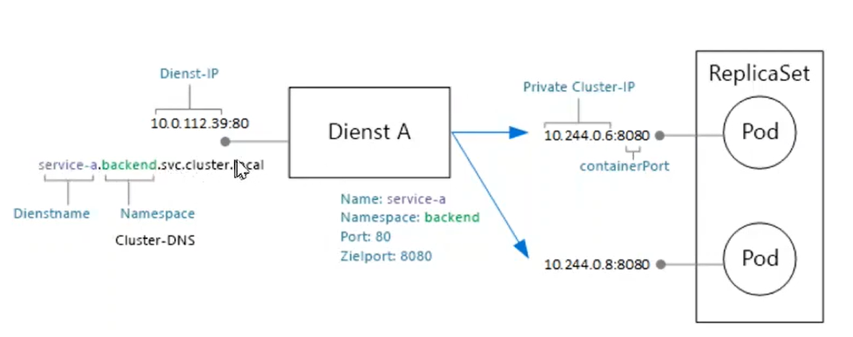
Replica Set: How many pods or application you want to run on the AKS cluster. That we do using yml files. Each pods contains containers.
Each pod occupies a private IP from the cluster.
Each node in AKS occupies 30 IP Addresses. That means each node of the cluster can spin up upto 30 pods. And again out of 30 will have some common ip address has to be there.
Service: Using service we communicate to the pods/application.
The service name is like servicename.namespace.svc.cluster.local.
NameSpace: It is logical space where we can create/manage pods. We restrict access to the developers based on their roles in day to day activity.
Create a cluster.
Dns name prefix: creates FQDN for our default cluster.
Virtual Nodes: It like excess nodes will come automatically, when ever we need or load load increases.
VM scaleset: If you enabled we can do autoscaling or do scaling manually.
Service pricinple/managed instance: user.
Network configuration: Has to enable if we need cluster has to create under a private network.

Slide 4
Login to the cluster:
az aks get-credentials --name
Cluster Autosalling:
Cluster upgrading.
Namespaces/Blue-Green stratogy:
In Kubernetes we can organiza our resources in namespaces.
Namespace is virtual cluster inside of the Kubernetes.
Once we create a cluster by default Kubernetes gives you 4 default namespaces.
Kubernetes-dashboard: Its only specific to minikube. In standard cluster you will not have this.
Kube-system: It is not meant for our use. We should not create anything or should not modify anything on this namespaces. The components are deployed here are system processes.
Kube-Public: This contains the publicly accessible data. This has config map that contains cluster information which accable without authentication.
Eg: kubectl cluster-info
4) Kube-node-lease: It holds the information about heartbeats of the nodes. This determines the availability of the node.
5) Default: This is the one we are going to use for creating the resources, if we are not created any of the namespace.

Slide 5
Create Namespaces:
We can do it using commandline. Eg: kubectl create namespace devops
For seing type: kubectl get namespaces.
We can also create this using yml files.
Create yml file and apply that. Eg: kubectl apply -f <file.yml>
What is the Need of namespaces:
Can be grouped the resources based on our requirement.
Many teams with same application.
Resource Sharing: Like nginx controller, elastic stack can be shared on all resources in the 2 different namespaces. If it 2 clusters then we need to reinstall same in 2nd cluster as well.
Limit the access from the namespace level.
POD:
This is main or smallest thing in AKS/K8S.
Docker container will be there inside of the pod.
It is main application. And our duty is protect this pod always.

Slide 6
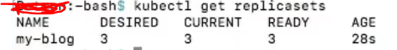
ReplicaSet:
This is required for pod to stay healthy.
Say suppose if our pod died, that means application died. So we have up the application as soon as possible, else our business will impact.
To make application up and running Kubernetes uses something called controller manager. The controller manager makes depends on the replicaset. In replicaset we maintain the desired no.of pods. If pod died immediately controller manager takes care of creating it again.
Like all the other componets even replicaset is also having 4 fields. 1) apiversion, 2) kind ,3)metadata, 4) spec.
Under spec we will have something called replicas=3, this is our desired option.
Template section is the one which replicaset. When pod based on the template section AKS automatically creates the another pod.
In replicaset template lables and selector lables should match.
Lables are important in this topics.
Pod labels vs ReplicaSet labels:
Replicaset can have its own labels. They will same like pod or can be different as well. And these 2 are completely unrelated.
Replicaset:
desired: How many we want.
Current: How many is currently running
Ready: How many pods are up and running and ready for use.

Slide 7
Replication Controller: Controllers are the brain behind the Kubernetes. This is the process the Kubernetes object that monitors and respond accordingly.
This works almost same like replicaset and also replica set standard and newer version when compared to replication controller.
That means when ever pod dies, replication controller work is to try create one more.
Command: kubectl get rc
Deployments:
Deployment does everything like replicaset does, but a deployment can also update the pods without any downtime.
Its update the newer pods to older pods slowly without having any downtime.
roleback deployments: If any problem happens at the time of deployment, if deployment option we have option to roll back the deployments to older deployment. So that our application is safe.
Each deployment creates the replicaset behind the scenes.
Deployments are lightweight. So everyone prefer deployments more than replicasets.
Deploment naming convenction:
Deployment name should be name which we specify in the manifest file.
Deployment creates replicaset and name would be: deploymentName-string
Pods will be created under the replicaset, the pods names would be: deploymentName-string-string

Slide 8
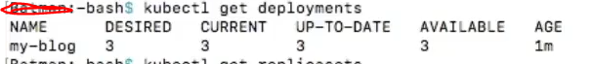
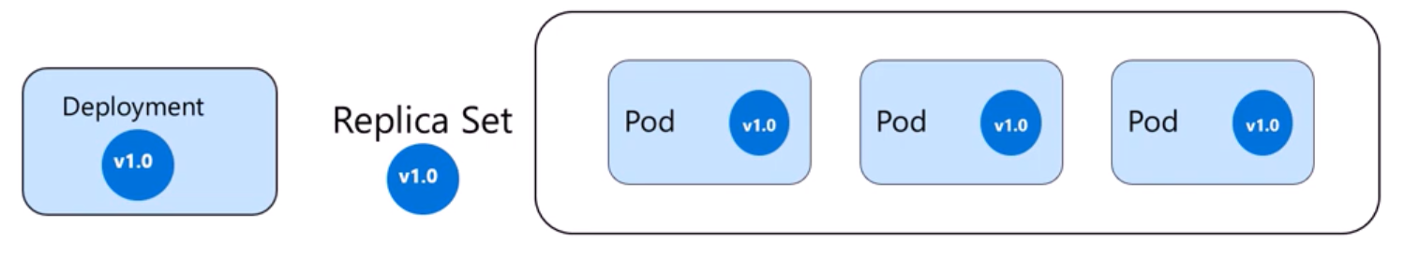
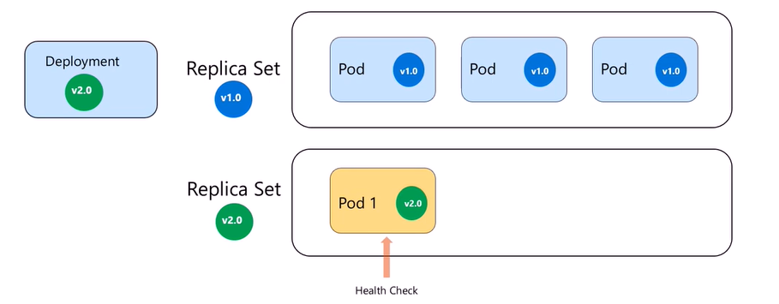
Deployment:
Desired: How may we want.
Current: How many created
Up-To-Date: How many of the pods are using current version of Kubernetes.
Available: How many pods are available.
Deployment Strategies: There are 2 types Deployment Strategies are there in the in AKS deployment.
Recreated: All pods gets killed and gets replaced by the new deployment.
Rolling update: Gradually updated the process which slowly replaces pods of the previous version of the application with instance of new version of application without downtime.

Slide 9
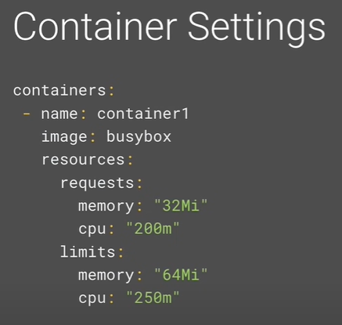
Max Surge: These are all the maximum no.of pods that can be created at a time. It would be in numbers or % value.
Max unavailability: Ensures only certain no.of pods are unavailable. It would be in numbers or % value.
Rollout deployments.
kubectl rollout undo deployment nodeapp --to-revision=2
Resource Quotas:
Pods:
When a pod is scheduled by Kubernetes its important that containers have enough resources.
If you schedule a large app in a small there is a possible that node gets effected/deleted.
End up having issues on application to run.
Requests and limits: Using the requests and limits we can restrict or limit the resources.
Requests: It is the minimum CPU and memory that we are allocating to a pod to run. Eg: 100mb and 1 CPU.
Limits: This is maximum value of the pod.
Cpu can be calculated in milli cores. 1CPU= 1000m.
Note: If your pod is kept cpu for 4CPU= 4000m, and your one of the node cpu is only 2CPU. Then yourPod can not be schedules same with memory as well.
→ Memory resources are defined in bites.

Slide 10
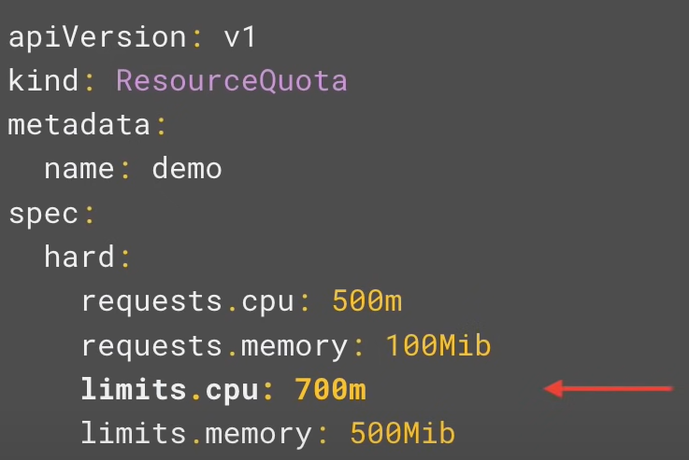
Quotas in namespaces:
It is best practice to set up the quotas for manespaces. Due to because of one of the pod in the one namespace issue other pods in another namespaces should not effect for their quotas issues.
To set up the resource quotas for namespace we use following terminalagies.
requests.cpu: This is the maximum combines CPU requests that all the pods in the namespace can have. Eg: If we have 50 containers, 10m each then the the request.cpu is 500m.
requests.memory: This is the maximum combines memory requests that all the pods in the namespace can have
limits.cpu: This is the maximum combines CPU limits that all the pods in the namespace can have.
limits.memory: This is the maximum combines memory limits that all the pods in the namespace can have.

Slide 11
Limit Ranges:
Default: Setup the default limits of the container in the pods.
Default request: It is default requests come that comes to the pods.
Max: This the maximum limit that a container in a pod can set. We can’t set this max value is less than the default value or vice versa. If we didn’t set default then the max will behave like default.
Min: This set up the minimum requests that pods or container can gets. Compared to Min the default should be lower than this.
Pod lifecycle:
→For creating a pod we usually write yml files and apply the file using kubectl command.
Pending: once we apply the file the pod will be in pending state. This is due to Kubernetes backend finding the node, for creating pod.
Creating: Once Kubernetes/schedulere finds out the node, now the pod will be in creating state.
Running: Once container created under the pod and all the commands we followed at the time of creating is proper then, pod will be running state. Due ting the running state the pod is up and running and all the containers inside are available to server customer.
Succeeded: Once pod achieved the main purpose, and containers inside of the pod gets deleted then pod moves to succeeded state.
Failed: It comes if any of the software issue or hardware issues comes to pod. If it comes we can check all the network, hardware like cpu, memory (or) may be a application itself (docker image).
Unknow: This is come if we don’t have any communication to the node but pod is up and running.
Crash loop backoff: If there is suicide command was there in the image or pod. Then pod tries to make as running, but because of wrong commands it will not gets up. And it will trying to make it up and running so many time by restarting the pod.

Slide 12
POD container relationship:
Pod designed to created one or more containers in the inside of it.
Recommended option is to create one container in one pod.
Init Container:
A pod can have one or more init containers.
Init containers it will run before our application run containers run. That means we have dependency with some other containers. If application containers have dependencies with more than one init containers all the init containers has to be run before application conainers.
Init containers are also looks like our regular application containers.
Init containers always tries to run for the completion, that means when we execute deployment file with init containers it should be successful. If it not successful, then init containers tries to restart again and again. And however we can change the behaviour by setting up the restart policies in the Kubernetes.
If you are having multiple init conatiners, first containers if executes successfully, then only it will move to another containers.
Init containers, after complete execution then those will be die itself.
Sidecar Containers:
Sidecar container is usually called as utility containers which basically supports our main containers.
Sidecar container can’t be created only one, it should create along with one main container to get the functionality of the sidecar container.
Attach ACR to AKS:

Slide 13
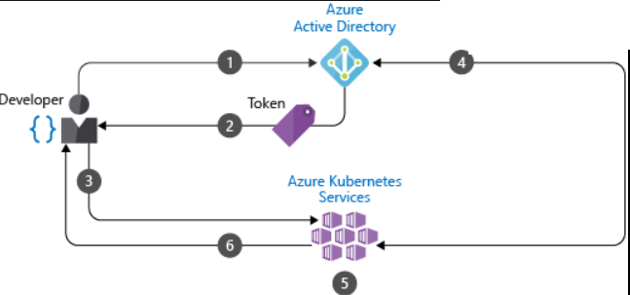
RBAC roles (role bindings):
Azure active directory with azure Kubernetes.
This uses to authorize/authenticate the users and restrict the users with on the resoruces which available in Kubernetes clusters like (pods, services, deployements etc…)

Slide 14
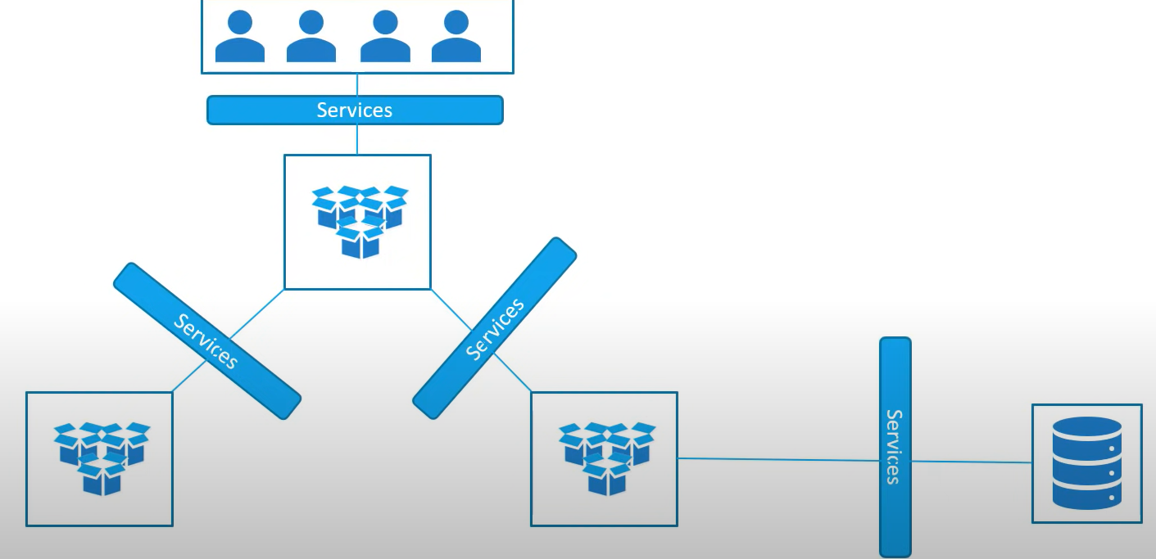
Services: Kubernetes services enables communication b/w various components within and outside to the application (pods).
Services helps us connect applications together with other applications for users.
For example our application has groups of pods such as group for service frount end loads to users and other group for running backend processors and third group can connect to an external datasource. The services that enables connectivity b/w these groups of pods.
In the above case services helps users to connect to front end application, also helps communication b/w backend and front end pods and helps connecting to an external data source.

Slide 15
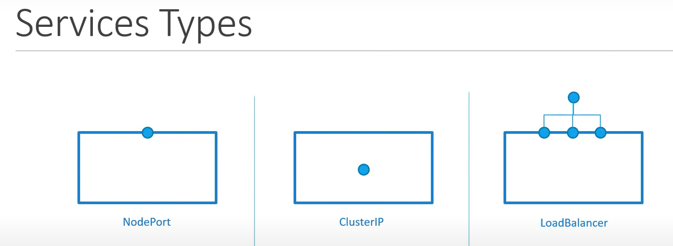
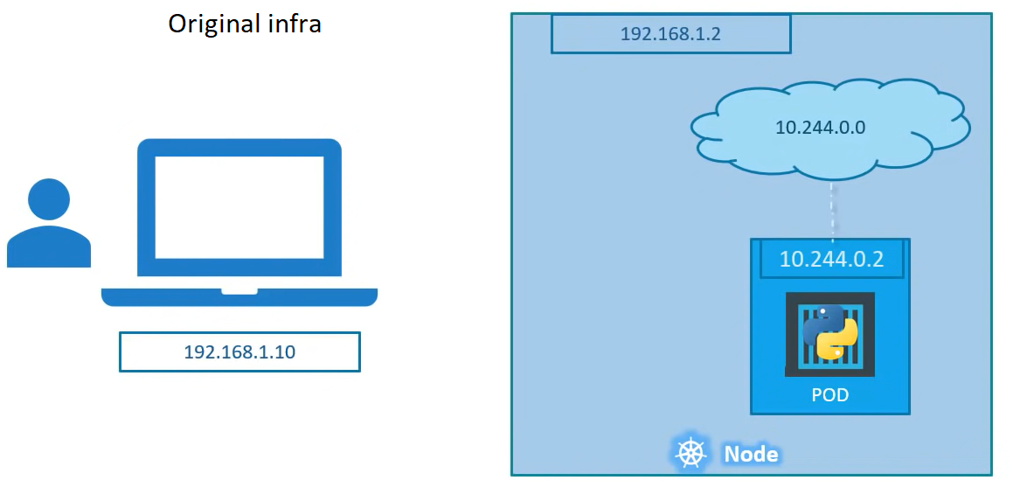
How an external connection establish to application inside of pod:
We deployed one web application inside of the pod on one of the cluster, but how an external user can access the application is the problem.
As per the above diagram we can’t access the application (pod) from our external network. Due to those networks are all different.
So there is should be a mechanism where we can access the application which is there in the pod. The mechanism is service.
A service is like a object in Kubernetes just like pod, replica set, deployment etc…
Service types:
NodePort: Where the service makes an internal pod accessible on a port on the node.
ClusteIP: In this case the service creates a virtual IP inside the cluster to enable communication b/w different services, such as a set of frount end servers to a set of backend server.
Load balencers: Where is provisions a load balencers for our applications in supported cloud provider. A good example for this is distribute the load across the different web servers in a front end tier.

Slide 16
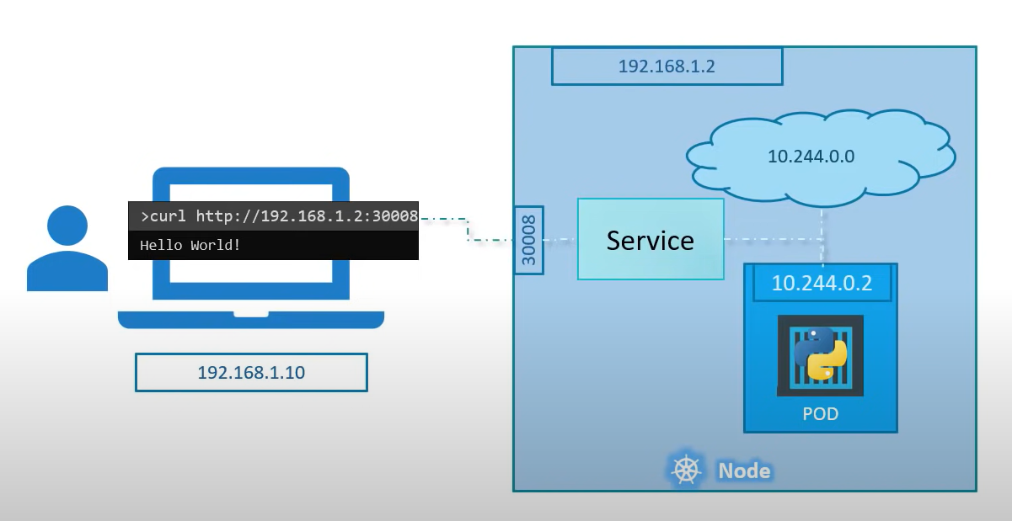
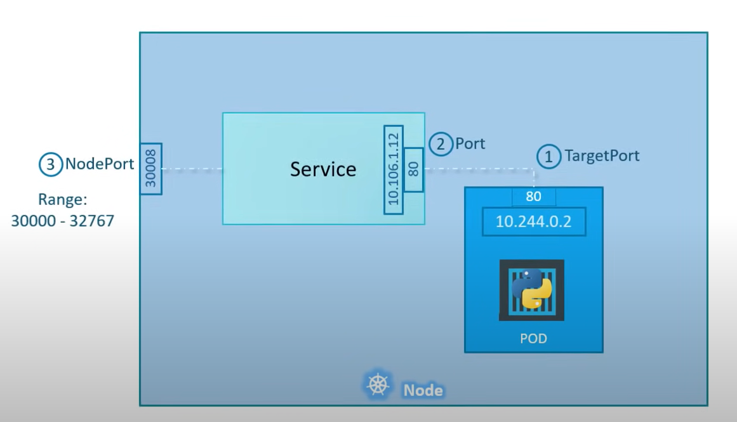
NodePort:
It only expose the application to external world using node port.
If we use the node port, this will open the same port to all the nodes in the cluster. So that we won’t face issue, if the pod is genereated in other node.
Node port range only from 30000 to 32767 ports. It is the recommendation from Kubernetes.
There is are 3 ports basically will be there in this this node port service.
Target port: The port on the pod is the actual web server port. PodIP:<portport> is the actual application. That means this is application port.
Port: This is the service (nodeport service) port. This is mostly port 80.
Nodeport: This is the port we are opening on node.

Slide 17
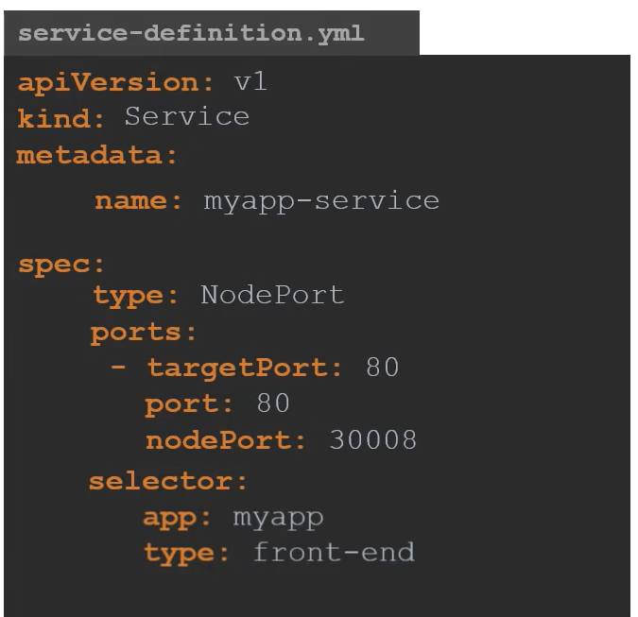
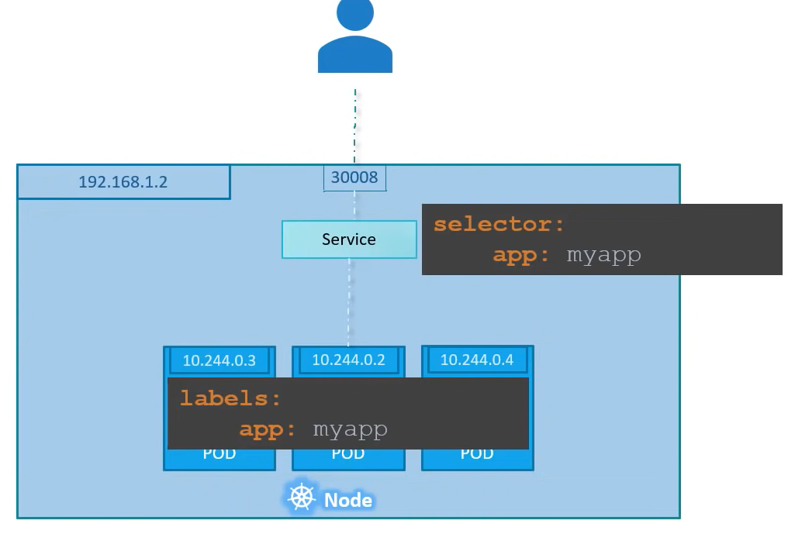
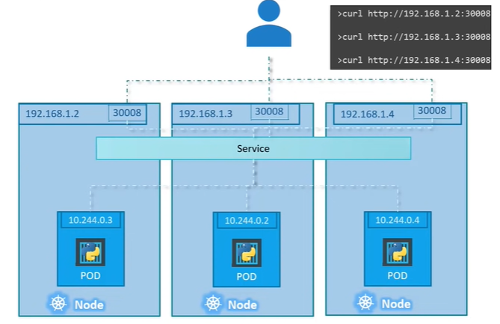
Nodeport Yml:
How service selects the deployment or pod: It uses lablels to select the target deployment/pod.
Kubectl apply –f <service.yml>
Kubectl get services (or)
Kubectl get svc.
Note: If we have multiple pods have to be loadbalenced then we need to have same labels of all
the pods and services.

Slide 18
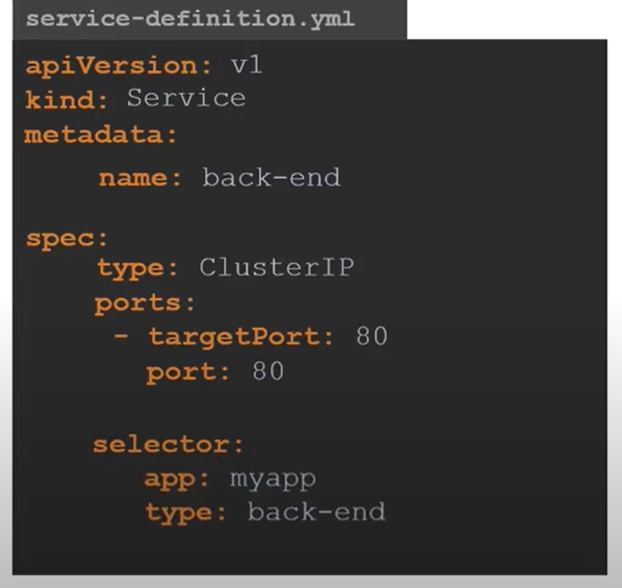
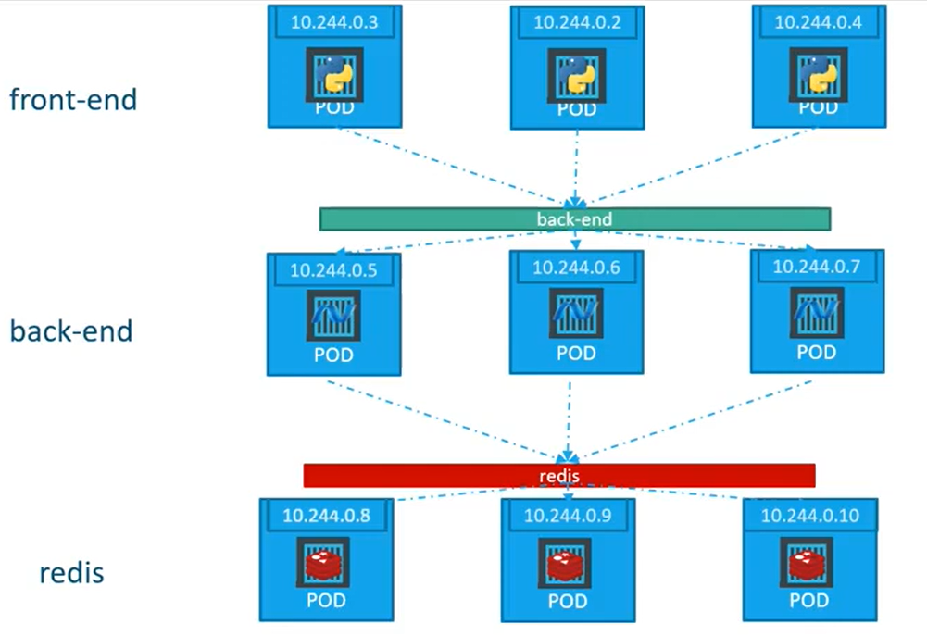
ClusterIP: A full stack web application will have different kinds of pods such as fountend pods, backend pods, db pods, or keystore pods etc..
EG: we have 3 pods running in frontend web server, 3 are from backend servers and a set of pods are running for DB. And these should connect each other to communicate and provide the better service to the end user. How these can be connect to each other is clusterIP service.
→ In Yml if we not specified type, then by default service will assume that it is clusterIP, so make sure if you are working on nodePort or load balencers provide them in the type session.
→ Again, all the load balancing happening based on the selector.

Slide 19
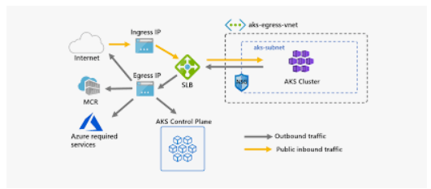
Load Balancing:
Just imaging using node port service you expose the web application to the internet to outside world.
Problem on nodeport load balancing:
It will open ports in all the nodes.
Proving the IP to the end user, which I noport IP and port has to provide? Due to pod may shift from one port to another port, once restrated or died and start again.
Load Balencers:
It is standard go to solutions, if we want to expose our app into internet/intranet.
It costs you dollars, that means load balancer is not free of cost.

Slide 20
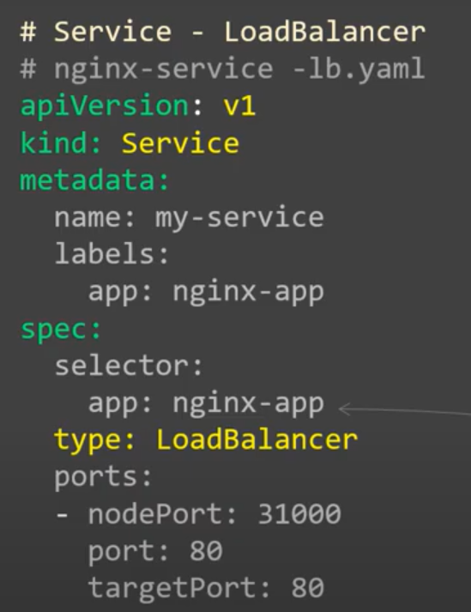
Load Balencer Manifest File:
The requirement of us is to expose the app into internet/intranet.
Metadata: we are providing name/ labels to the service.
Selector: This selects the deployment/pods.
Type: This should be load balencers.
Ports: 3 types.
Nodeport: This is not mandatory. If we not specify anything kubenetes will select one port.
Port: this is the port of the load balancer. And this is very much mandatory.
Target port: This is port of application (or) which port the application has exposed inside of the Container.
Kubectl apply –f <manifest.yml>
Kubectl get svc. Kubectl describe svc <name of the service>
We can see information.
type: It shoud be load balancer.
Endpont: is the pod ip. (This will shows how many pods it has been load balanced.
→ Using external ip of the load balancer we can expose applications to external world.
Kubectl delete –f <loadbalencer.yml>
Kubectl delete service <servicename>

Slide 21
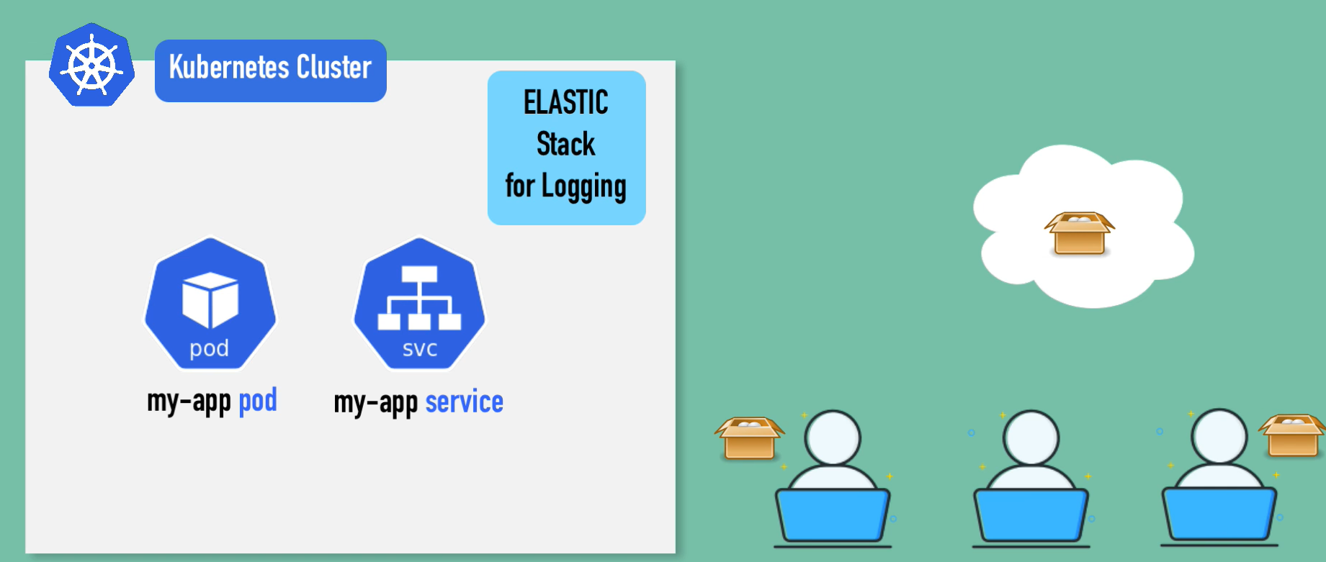
Helm:
Helm has couple of main feature that is used for.
It is a packaged manager for Kubernetes. So its like apt, yum, bru etc.. For Kubernetes.
This is the convenient way for packaging collections of Kubernetes yml files and distributing them in public and private registries.
Eg: we have deployed our application in AKS, we want to install elastic stack for collecting logs. Generally we have to follow the lot of steps to do that such as statefull set, config Map, secret, RBAC, services etc…. For writing everything and takes some high effort. So helm will have one public repo where we will be having all these ymls that means someone created these ymls and made it available in public repository. So using simple command we can install this elastic stake. That bundle of ymls we called as helm charts.
We can create our own helm charts using some standard process.
We can push them to helm repository public/private.
We can download and use an existing helm charts.

Slide 22
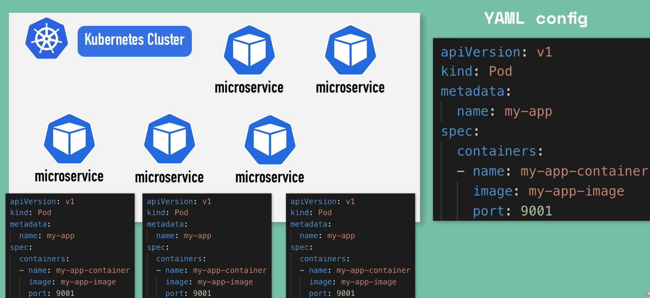
Helm charts:
Commonly used applications like databases, ingress, keystores, monitoring apps etc.. All have chart available in the internet.
So simple helm install <package>, we can use the configuration which some one have already did it without any additional efforts of us.
Sharing helm charts:
If you have AKS cluster and we need some kind of deployment, that some one has already intialised and pushed in public helm repo, we can use command like [helm search <keyword>]
Helms own public repo like helm hub.
Public Registries: Discover and launch the greate kubernets-ready apps.
Private Registries: Share the registries amount organizations.
Note: Heml is a templating engine.
Templating engine:
Without helm

Slide 23
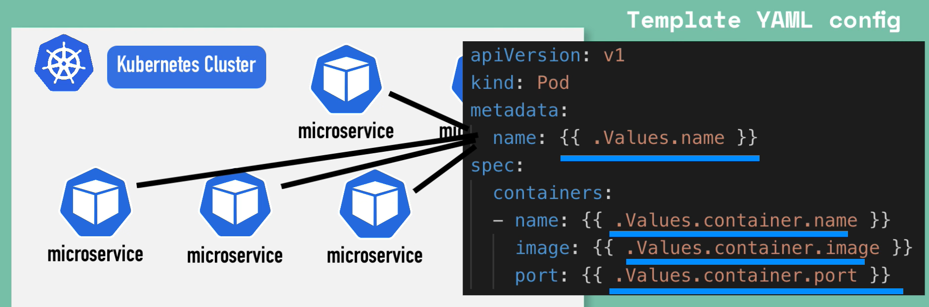
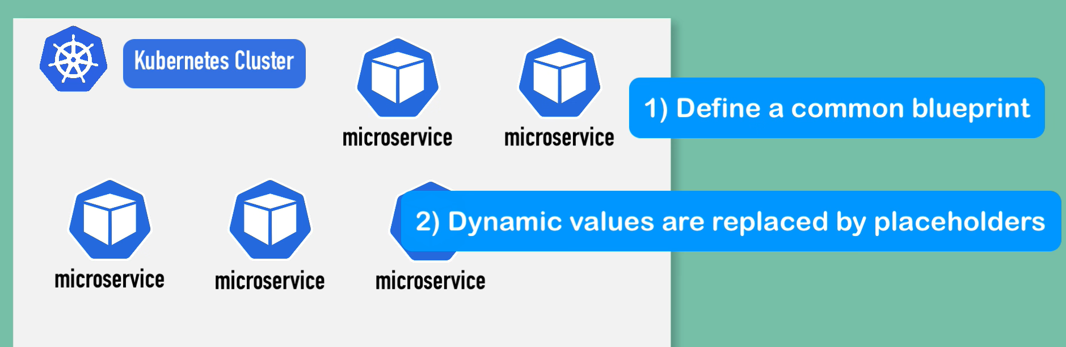
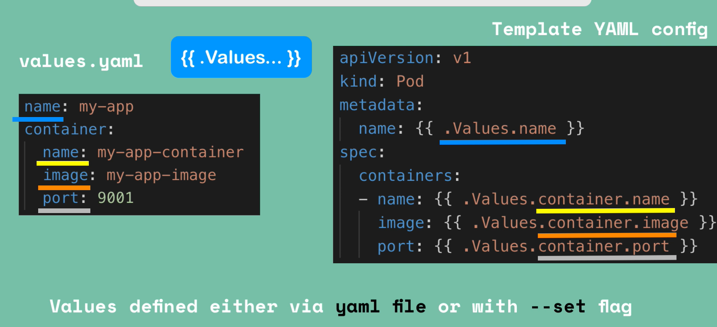
With Helm:
We write template files and keep the values in value file or from the command line.

Slide 24
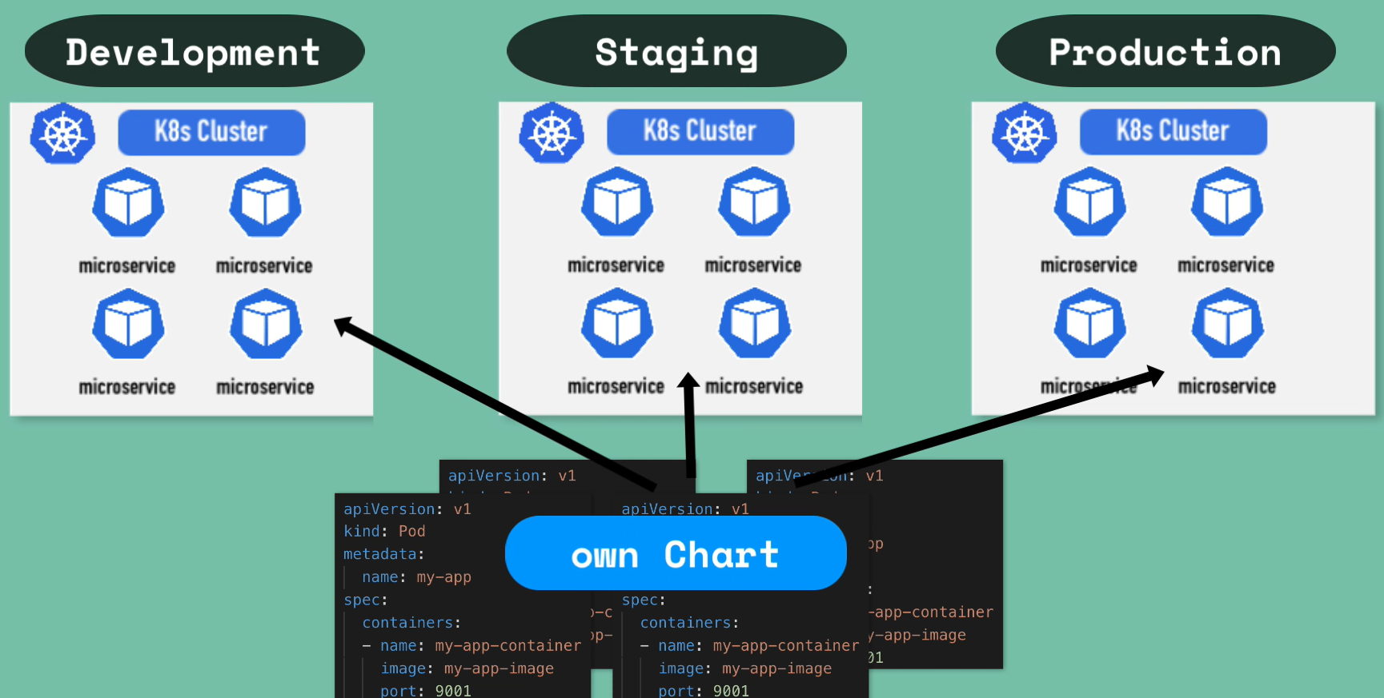
Templating engine: Another use about this is we can use the same applications across different environments or clusters.

Slide 25
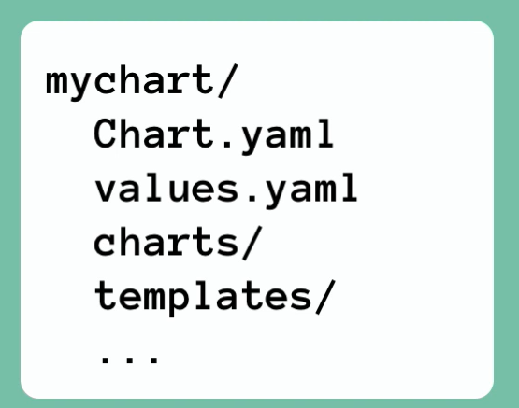
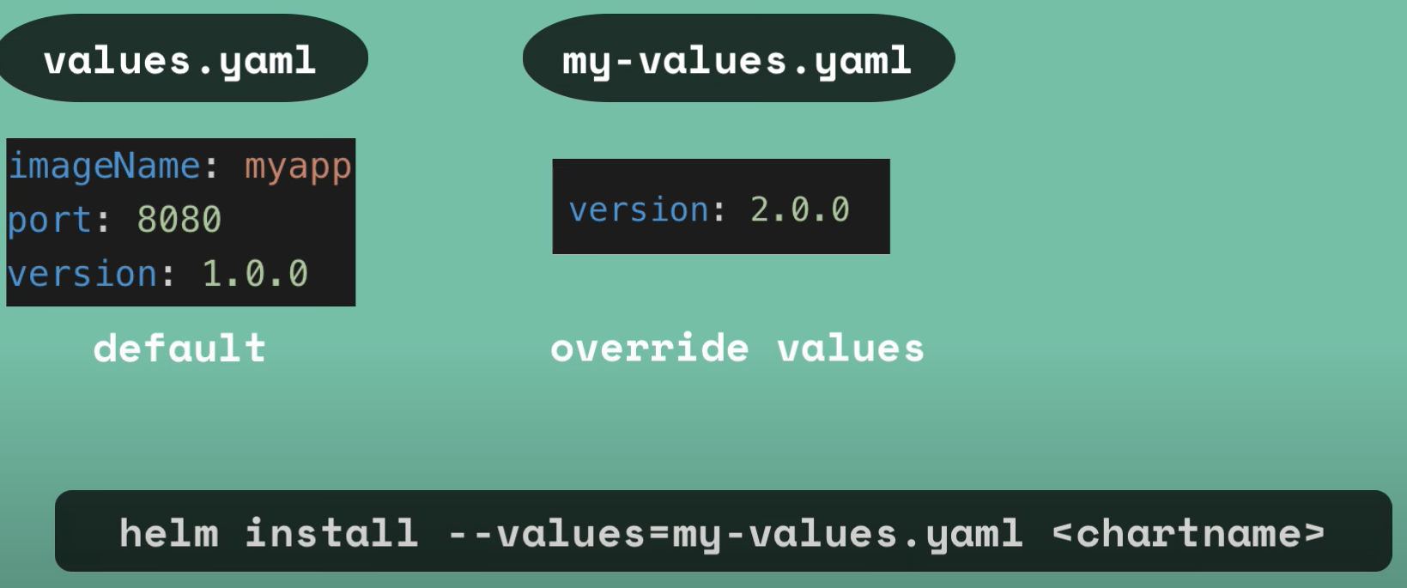
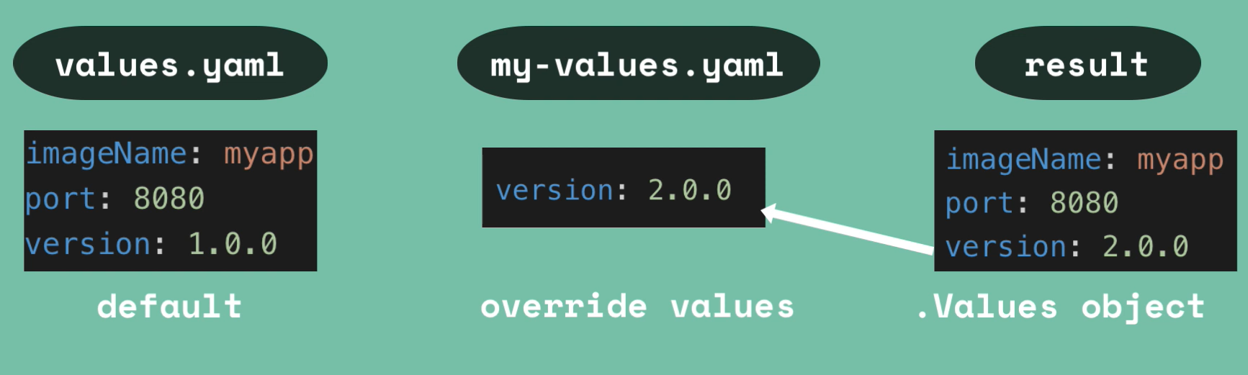
Helm Chart Structure:
Typically chart is made of directory structure.
Top level would be the name of the chart.
Chart.yml that contains all the meta info about the charts. Could be name, version, list of dependencies, etc…
Values.yml is the place where all the values will be configured for the template files. And these are actually
default values and we can override it later from the command prompt.
Charts directory will have the charts dependencies
Template folder/directory is like where our actual template files are stored.
Command: helm install <chartName>
How values are getting injecting into the template files:
→Suppose you have one values.yml file with some values, that can be overwritten by another yml file. Then those will merge and results .yml file.

Slide 26
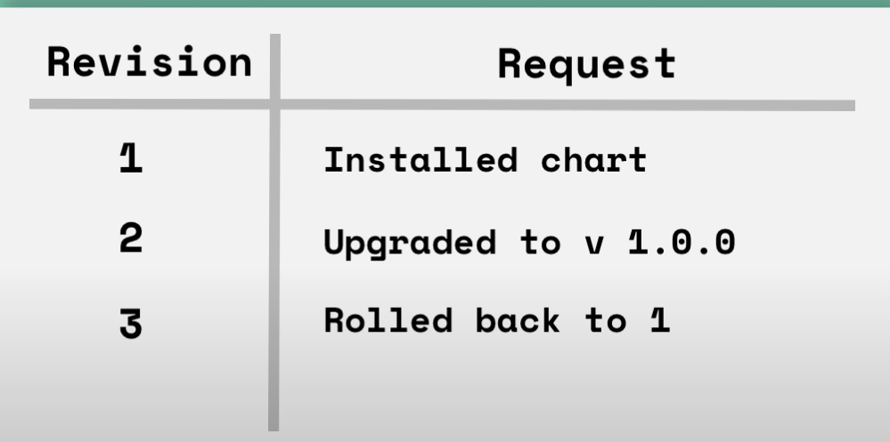
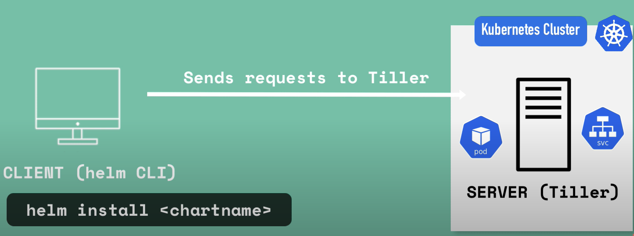
Or we can overwrite the default yml using command line by setting up the set flag.
helm install --set version=2.0.0
Release Management: Release management can only done on helm 2 not on helm 3.
→First of all we should understood what is helm cli and tiller. Client is helm cli and tiller is server.
When ever we try helm install, then helm client will send the ymls to the tiller, then till will do the deployment in the AKS.
In this architecture we have one valuable feature of helm that is release management.
When ever we do the deployment then tillar stores the ymls for future references. And also for each execution of charts tillar will make one revision same like deployment in the AKS.
For example if any of the helm request failed we can always go back to the previous version by typing command called [rolled back to revision number]
But the problem here is helm is external entity, this is able update, delete, create deployments. This is big issue from security prospective. So helm removed the release management in their version 3. So we won’t see release management in helm 3.

Slide 27
Install helm:
https://helm.sh/docs/intro/install/
Commands:
Helm version
Helm search repo
Helm search repo wordpress
Helm search repo nginx
Helm search hub nginx
Helm hub → click on charts → click on that
helm repo add bitnami https://charts.bitnami.com/bitnami
Helm search repo nginx
Now we can see the charts in local.
For downloading we can use the following command.
Helm pull <helmChartName> --untar=true
Helm install < name what we want> <helmChartName>

Slide 28
Creating the Helm charts:
Create charts using helm create command. After this command we will get one folder structure.
I) Template: this folder is important. Here only we will have all our yml files (or) Kubernetes objects will be there.
Inside of it we will have.
Test: This is the folder available under the template folder. This is important, if any dependent application has to be run for making our current application up, then we use this test folder. Before running the helm chart first the helm will run the ymls which are under the test folder.
_helper.tpl: This is a kind of place where we write functions. Eg: repeated labels can be handled here. That we write here those labels and in ymls we simply call this functions. This helps minimise the repeated work also we can change the labels based on our requirement.
NOTES.txt: once we deploy the chart to Kubernetes the data inside of the NOTES.txt file will be seen at the console.
II) .helmignore: This is similar to .gitignore.
III) Chart.yml: This basically contains the metadata of our charts. Like name, description, type, apiversion, version.
IV) Values.yml: All the values of the template directory will be present here.
Helm lint: this will check our charts are proper or not. Command is helm lint ./<directoryName>
Helm commands:
helm completion: This command generates auto completion scripts. This gives us a shell script, and we can make our shortcuts for my helm.
Create: This create the chart. If we create helm chart with same name in same folder, the helm just overwrite the existing charts.
Dependency: used to manage the dependencies in helm. Eg: my charts have a dependency on key valut, so that can be updated in charts directory. Actually all the depencies will be written in the charts.yml, then at the time of run (chart installation), all the dependencies will come to the charts directory. And also will create one file called Chart.lock. And that chart.lock file contains the dependency information.
Similartly add some other dependencies and test them.

Slide 29
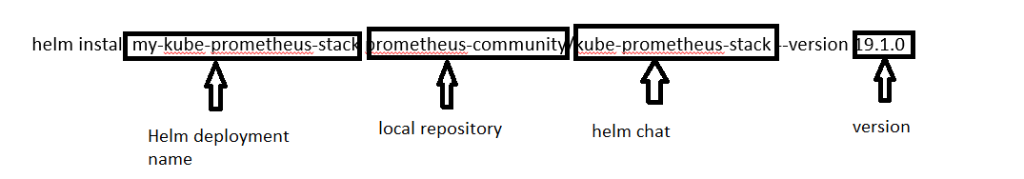
Env: Basically aUsed to download the extended information vailable for helm client environment information.
Get: of named releases.
Install:
Package:
Pull: it is basically to pull the chart.
Helm repo: Through which we can add a repos. Then we can use the same. Once we added the repository local. We can directly install it using helm install command. The repository it will to local name of the same.
Eg: helm install my-kube-prometheus-stack prometheus-community/kube-prometheus-stack --version 19.1.0
Show: Basically shows the information about the charts.
Status: shows the status of the named releases.

Slide 30
Built in objects in helm:
Object is a combination of data and procedure working on the available data.
An object has a state and behaviour.
A state of the object is stored in fields (variables), while methods (functions) display the object behaviour.
In helm objects are passed into the template folder (template engine).
Your code can pass the objects around and three are even into few days to create new objects withing your template, like tuple function.
Release: This object describes the release. And have several objects. It holds
Release.Name: release name itself.
Release.Namespace: Nothing is provide the value it will consider as default.
Release.IsUpgrade: This will be set to true, if you are upgrading something.
Release.IsInstall:
Release.Revision:
Release.Service: Which service is renduring the template.
2) Charts:
→ Any data provided in chart.yml will be accessable here.

Slide 31
Kubernetes Secrets with Azure key vault:
We can store keys in 2 different ways those are 1) config Map 2) secrets using azure key vault.
Config Map: storage only environment specific variables.
Secrets: This is the best method to store any of the username/ password etc.. This would be encrypted manner.
Pre-requisites:
Kubernetes running 1.16.0 or higher.
Azure key vault.
Secrets using azure key vault:
This has good feature like key rotation, that means we can update our secrets frequently.
Have good features for strong encryption.
Components for this workshop:
Azure Key Vault
CSI provider connect to azure key vault and will retrieve secrets.
Secret store object for getting the key vault information like name, rg, etc..
POD
4
Pod will
mount the
csi volume
For accessessing
The secrets.
3
Secret store CSI/KV
Identity
1
Grant Access
5
2
AAD pod identity
Mount volume

Slide 32
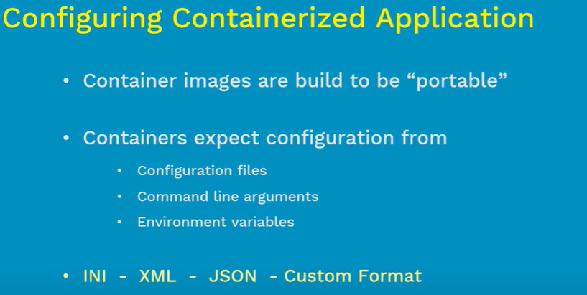
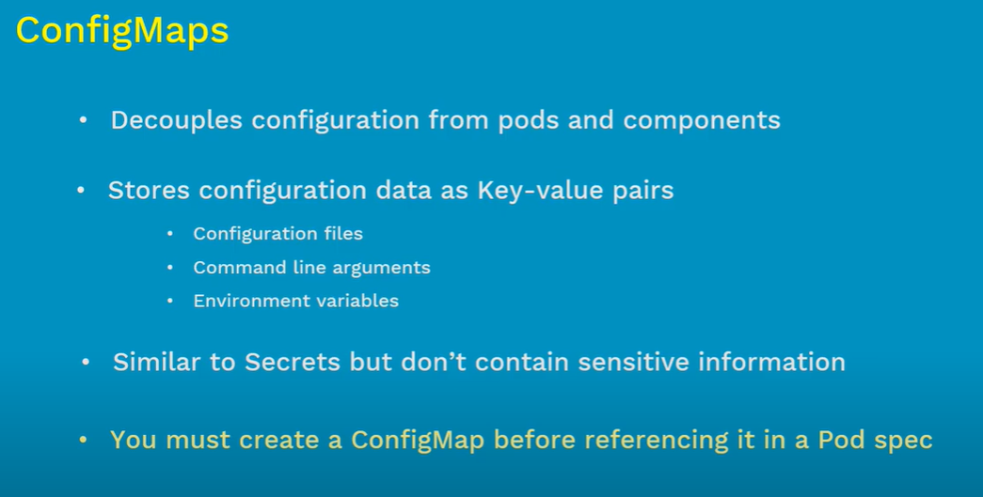
configMap:

Slide 33
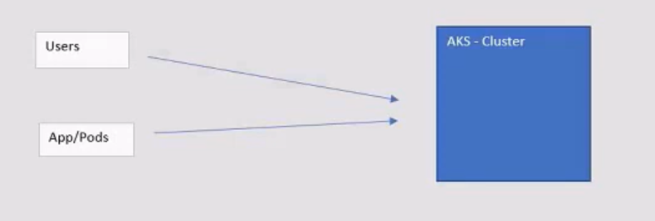
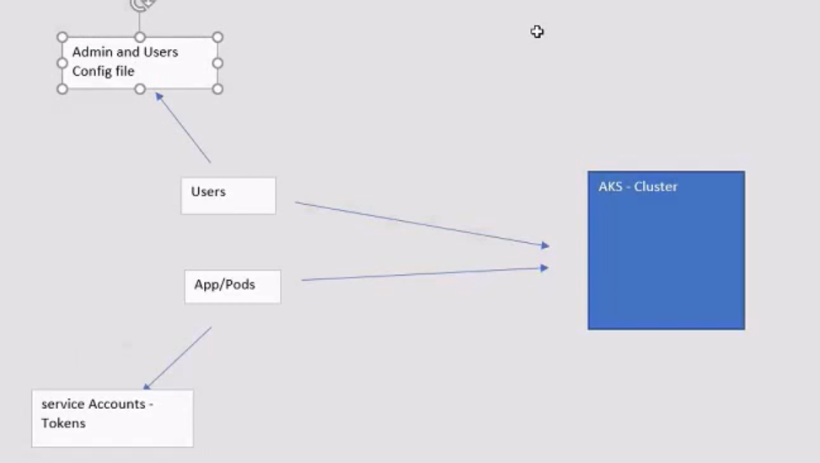
Kubeconfig:
az aks get-credentials --resource-group <RG> --name <clusterName>
Once the above command gets executed we will get one file in .kube/config in our local. Using that file only we can able to login to the cluster.
Default windows path C:\Users\<users>\.kube
Do cat ./kube/config → we see all the data.
Service Account:
Usually there are 2 kinds of access/identity for AKS cluster.
One is users access, that we are handling using role/rolebindings using azure AD. We provide proper access to the admin, developers, operations teams etc.. Based on their job role.
Second one is to provide access to the pods, in order to communicate to the api server to perform some actions such as interacting with other pods in the cluster, expose itself to a service outside the web address, or reaching out to the another resource in azure such as ACI, ACR etc..
That means the pods need to authenticate themselves to the api server. Service account is the one which helps pods for the authentication.
Service account has the required tokens which is used by pods to authenticate themselves to perform the action.

Slide 34
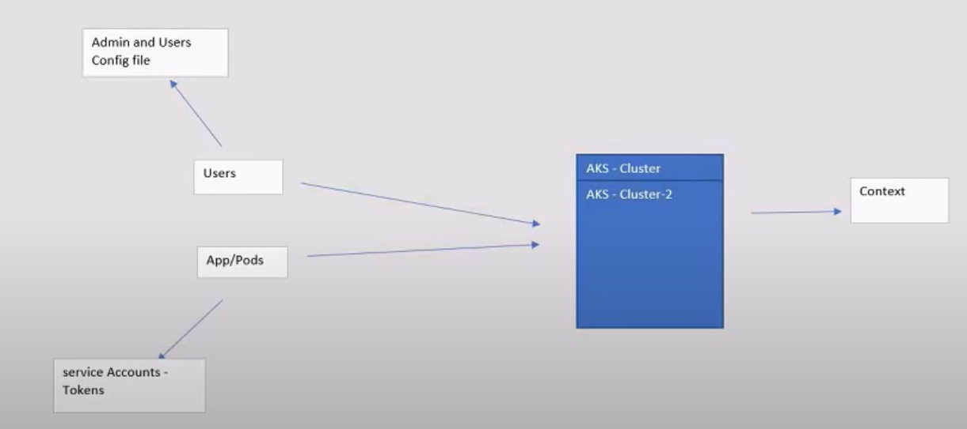
Context:
Suppose we have multiple clusters and we tried to login to the cluster using a single kube-config file. So we maintain something called context in the kube-config file. So based on the context is set the local machine, we will be working on that cluster.

Slide 35
Ingress:
Ssl certs:
Service account:
Kubeconfig file
Storage:
secrets:
Heml:
Ssh-file (how to login to node)

Slide 36
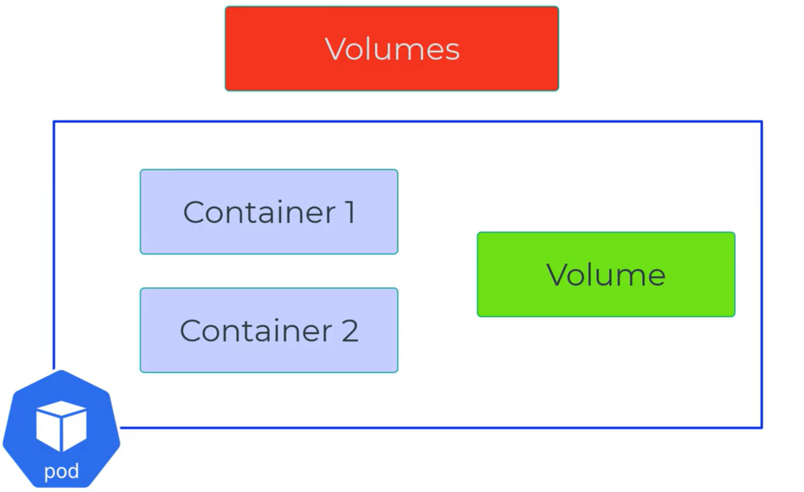
AKS secrets: We create secrets to store some of the data into the manifest file in a secure manner. We can create in command line or in yml files. Or also using key vault.
kubectl create secret generic azure-secret --from-literal=azurestorageaccountname=mystorage12543554 --from-literal=azurestorageaccountkey=W+dzwjW//KO7w42VsMP6FFbI969ZEnCRTzx1Su604nKq8/BoVhYE4rahXTdYjW0Mi58mV0VDrgBI1POD3SZkww==
Storage:
We use them for storing the data. In AKS we have 2 tyes they are volumes and persistent volumes.
Volumes: Volumes provides an option of providing the storage to the containers inside of the pod. This volumes is available in all the containers available inside of the pod. Even one of the containers fails does not effect the data stored in the volume.
But this volume will be created at the time of pod creation and deleted at the time of pod deletion.
Life cycle of the volume= lifecycle of the pod.
** Not only for pod deletion, even pod restarted then volume will be lost.

Slide 37
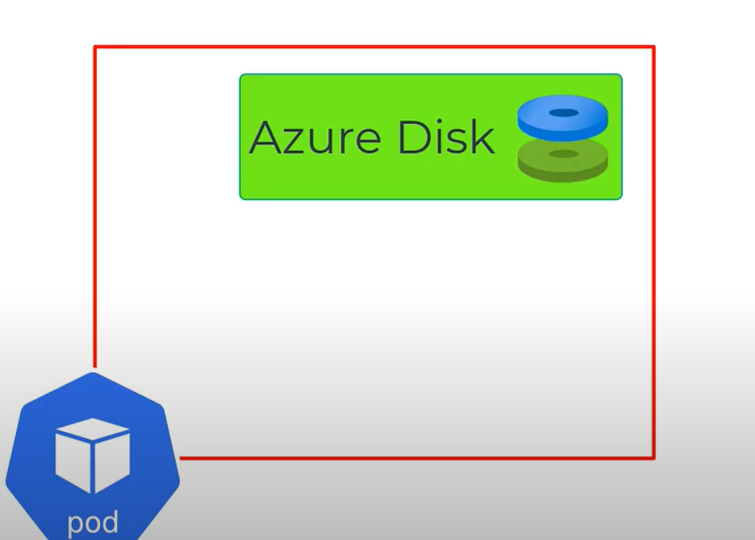
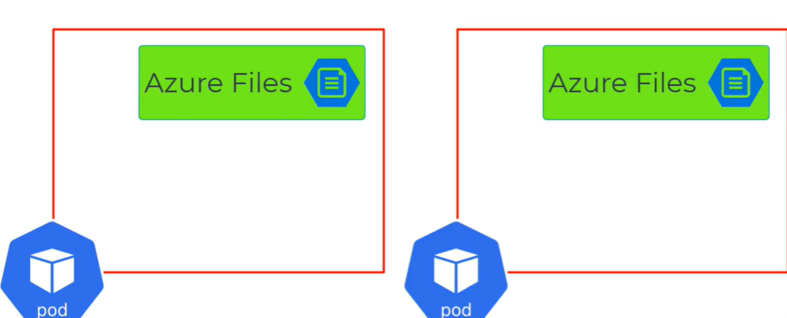
Azure Disks: This is good if we are attaching for a single pod.
Azure Files: If we want to share the data across the pods/contianers we need to azure files.

Slide 38
We know volume is created at the time of pod creation, but in reality we want the containers has to be use the volumes.
This will done at the time of creation of pod we do mount them as a manifest files.
Types of volumes:
Azure Disks: Let say we want a volume to be attached to only one pod and should not accessable to another pod. That use case we use azure Disks.
2) Azure Files: If you wanted to have multiple pods has to be access the same volumes we use azure files.
Create a storage account, create a fileshare withing the storage account and then create a aks secret using the commanline and then use it.
kubectl create secret generic azure-secret --from-literal=azurestorageaccountname=mystorage12543554 --from-literal=azurestorageaccountkey=W+dzwjW//KO7w42VsMP6FFbI969ZEnCRTzx1Su604nKq8/BoVhYE4rahXTdYjW0Mi58mV0VDrgBI1POD3SZkww==
3) Empty Dir: commonly used as a temarory storage in AKS. This storage underlying node starage or node memory. Once pod deleted the data and volume gets deleted.
4) Secrets: This is also one of the volume. This created using AKS api. Used to store the secret information such as passwords.
kubectl create secret generic azure-secret --from-literal=azurestorageaccountname=mystorage12543554 --from-literal=azurestorageaccountkey=W+dzwjW//KO7w42VsMP6FFbI969ZEnCRTzx1Su604nKq8/BoVhYE4rahXTdYjW0Mi58mV0VDrgBI1POD3SZkww==
5) Config Maps: Also like a secretes only difference some extra data we used to inject here.

Slide 39
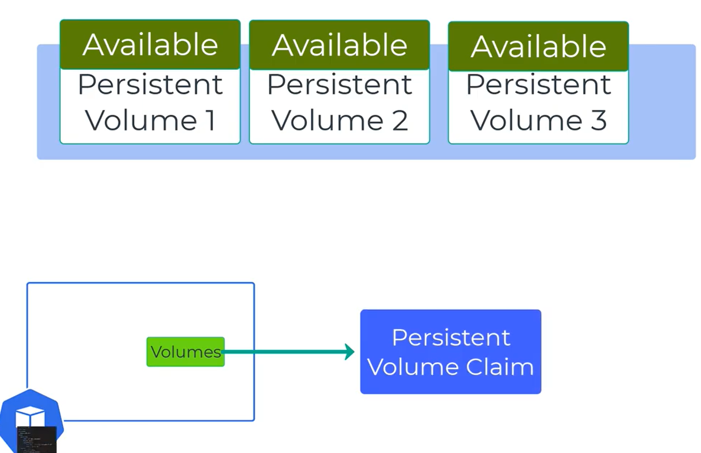
Persistent Volumes: We need to get the data even though the pod gets deleted from the cluster, that case we use persistent volume. Persistant volumes can be provisioned in 2 ways.
Static way
Dynamic Way
Static:
First Create the persistence volume using disks or file storage
Imp things to learn:
labels: With this only we bound the pod and persistent volumes.
Storage capacity: How much storage we want.
AccessMOde: Kind the of access that this persistent volume will have (ReadWriteMany, ReadWriteOnce, ReadOnlyMany)
persistentVolumeReclaimPolicy:
Type of storage: It could be azure files, disks, ….
Once persistence volume gets created we can see those persistence volumes have been created in the AKS cluster. That means those are available and are ready to claim.

Slide 40
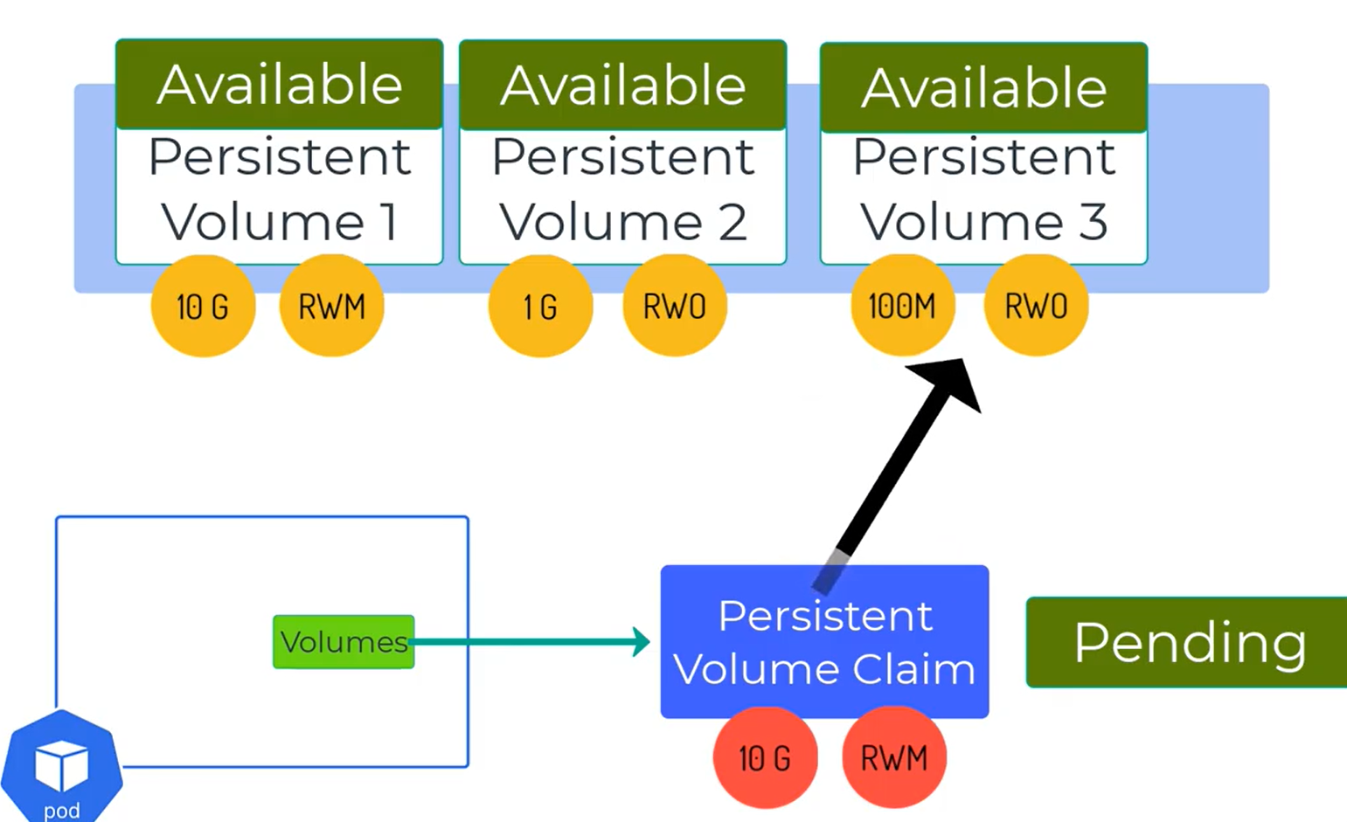
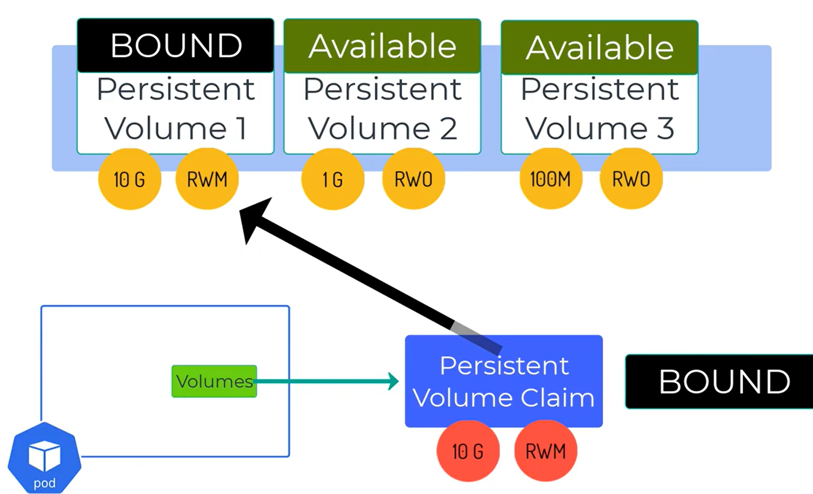
Now we need to mount this to a pod using persistence volume claim. So we need to create persistence volume claim. Then mount the persistence volumes to pods using persistence volume claim.
Persistence volume claim:
Storage: size what app needs.
accessMode: The access mode that the app needs.
Annotations: This is tells AKS to not to create a new storage account/disks, but pick the resources from the existing storage account/disks.
Once persistence volume claim created, the AKS will search for available persistence volume and bound it once it finds. Till bound the persistent volume claim bounded it will be pending state.
Once persistant volume and claims bounded those will be in bound state.

Slide 41
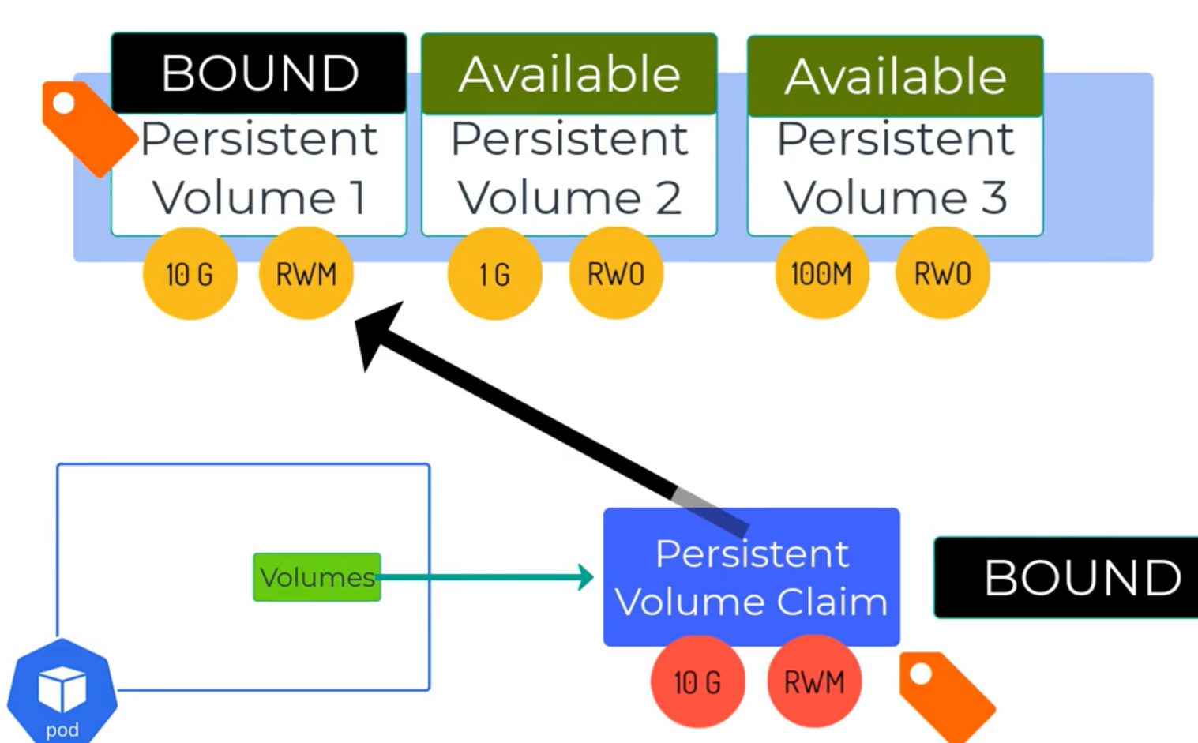
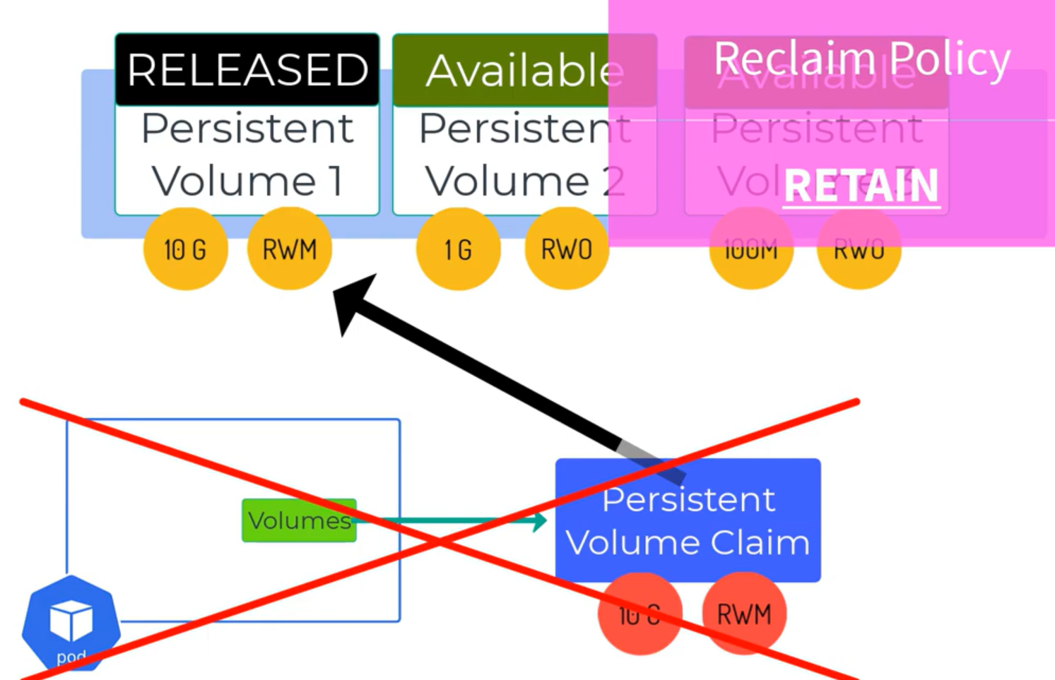
If we want to picks the exact persistent volume to the persistent volume claim, then we need to use the same label selectors in the persistent volume and persistent volume claims.
Note: ** Persistant volumes no need to be in the same namespace but persistant volume claims and pods should be in the same namespace.
Reclaim Policy:
Suppose the pods/apps has been deleted and organization no longer needs the app. That means pod/persistent volume claim gets deleted. How about persistent volume and the underlying storage?
Ans: This can be specified in the reclaim policy of the persistent volume yml.
→ Reclaim Policy: Retain= Then the volume will change the phase from available to released. And the data will still be available. And no other pod can claim this particular persistent volume.

Slide 42
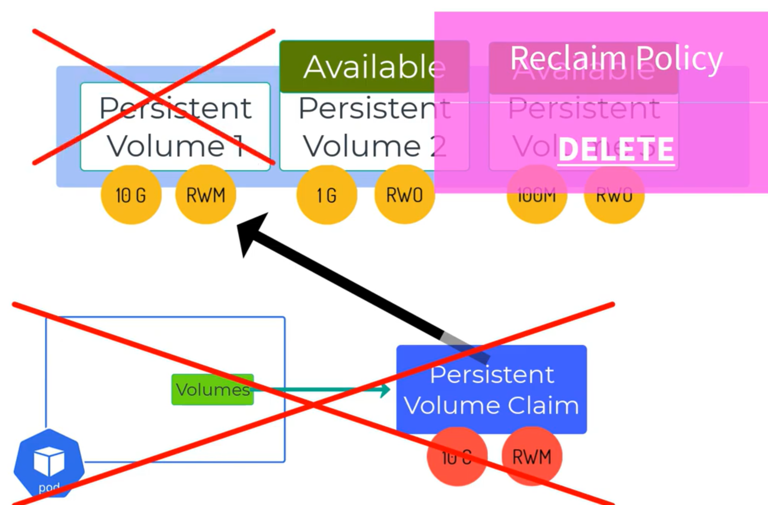
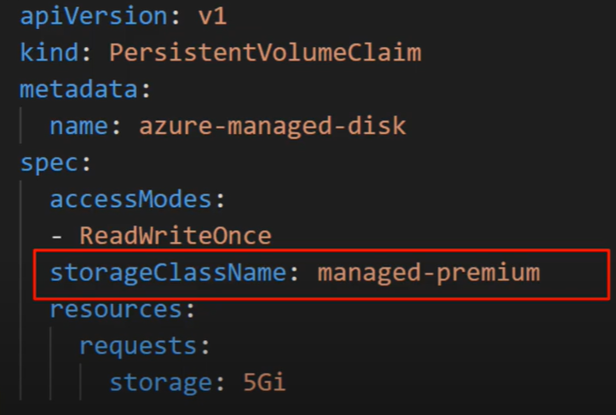
ReclaimPolicy:Delete= In this case the persistent volume and the underlying storage account get deleted automatically once the app gets deleted.
Dynamic/Storage Class:
Dynamic means we don’t need to create any persistent volume, AKS automatically will create this one. This we called as storage classes.
We create persistent volume claim, and persistent volume claim yml this time would be slightly different. This will have the storageClassName.
Based on the storage class name specified in the pesistent volume claim and applied this into the pod, then AKS will automatically create underlying storage and persistent volume in the AKS.

Slide 43

Types of Storage Class: In AKS we have inbuilt storage classes available. Those will create behind the actions.
If we not specifty storageclassname in the manifest file, then it will managed disks and that to standard ssd. Also this will create persistent volume.
Similarly managed-premium, azureFile, azureFile-premium, will create different types of storage and persistent volumes.
And the created persistent volume and persistant volume claim always bound to each other until and unless which gets deleted.
Note: All the persistent volume which gets creating now a days using the storage class will have reclaim policy as delete, that means once the persistent volume claim/pod gets delete the underlying objects/persistent volume also will gets deleted automatically.

Slide 44

→ We also can the reclaim policy based on our requirement, but for that need to one custom storage class.

Slide 45
Ingress:
In Kubernetes we can expose our services using something called load balancers service. That would create a public IP address for each one of your services.
Each public IP will cost you something. In order to get rid of the additional cost to the company and also route the traffic via our custom DNS with https protocol. We need one ingress controller and ingress for this.
This also helps to route the traffic if /webapps1 as one application and /webapps2 as another application. Etc…
We are using our open DNS nip.io for our demo.
Kubernetes api provides the interface for ingress controller but not the implementation of ingress controller that means we need to install the ingress controller.
There are different kinds of ingress controller are available for Kubernetes over the internet those are Nginx, HA-Proxy, App Gateway, citrix ingress controller, aws alb ingress controller etc…
Demo: install ingress controller using helm charts, create 2 demo applications, create ingress resource in order to map the ingress to the applications.

